Slide 1


OCoR: An Overlapping-Aware Code Retriever
ASE - 2020
Qihao Zhu, Zeyu Sun, Xiran Liang, Yingfei Xiong, Lu Zhang
Peking University
Notes:
Good morning.
I am Qihao Zhu from Peking University, Beijing, China.
This is our paper “OCoR: An Overlapping-Aware Code Retriever”.

Slide 2
Introduction
PART ONE
Notes:
I will first introduce the introduction of our paper.

Slide 3
Code Retrieval
SQL Query for :
Rows linked by one joint table INSERT to another joint table
insert into joint_table_b (sid, uid) select students.sid,1 as uid from student s, joint_table_a a where s.sid = a.sid and hid = 3;
select e.lastname, d.department_name from employees a left join departments d on d.departmentid = e.departmentid
select a.cname, count (b.name) from idtb a left join usrs b on (a.cid = b.cid) group by a.cname
0.98
0.32
0.34
Natural Language
Description
Candidate Code (SQL)
Score
Notes:
So, first.
It may often happen that when we want to retrieve some relevant code among a set of candidate code snippets with a specific functional description.
Hopefully, a code retrieval system can automatically generate the relevance score between each code snippet and the input natural language description. Then, the system rank the code snippets in the set of candidate code snippets to select the most relevant one.
For example, as the figure shown, given the natural language description Rows… each code snippet is given a relevant score in the right box. And we then select the highest one as the result.

Slide 4
Code Retrieval
How to open a file in java
How to initialize an array
Searching the relevant code from natural language description.
Use ‘iterator’ to visit an array
…
Software Development
Code Retrieval is beneficial in various scenarios.
Beginner
Programmer
Notes:
As we know, there are thousands of source codes in GitHub and StackOverflow etc. An effective code retriever helps developers retrieve the most relevant code snippets from these resources to improve the efficiency of software development. Such code retrieval is beneficial in various scenarios including software development, learning，software maintainment, and so on.
How to retrieve the relevant code from thousands of source code is an important but challenging task in software engineering.

Slide 5
Code Retrieval
State-of-the-art approaches mostly embed the question and the answer into a high-dimensional vector space.
Code tokens
tok₁, …, tok_{n}
Sequence
Encoder
Distance
Query tokens
tok₁, …, tok_{n}
Sequence
Encoder
Notes:
To solve this task. Previous state-of-the-art approaches mostly embed the question and the answer into a high-dimensional vector space and try to find the most similar one between the vectors of questions and the vectors of answers through computing cosine similarity

Slide 6
Code Retrieval
The previous approaches fail to effectively handle overlaps which are important in code retrieval.
Different programers may use different names to describe the similar meanings and such names often have overlapped substrings.
“Sort” and “QuickSort”
“Line1” and “Line2”
“Joint_table_a ” and “Joint_table_b”
Identifiers in code are often related to words in the natural language description.
one joint table and “Join_table_a”
Notes:
However, the previous approaches failed to effectively handle overlaps which are important in code retrieval. As we know, thousands of code snippets for training may lead to a big vocabulary which the model is difficult to handle. The existed approaches almost replace the identifiers with some placeholders to alleviate this problem. However, this approach may lead to the lack of the information of overlaps which are important in code retrieval, either in code or in natural languages.
Firstly, Different programers may use different names to describe the similar meanings and such names often have overlapped substrings, such as “Sort” and “QuickSort”.
Secondly, Identifiers in code are often related to words in the natural language description, such as ”one joint table a”and “joint_table_a”.
As far as we are aware, no existing neural architecture is specifically designed for handling overlaps.

Slide 7
OCoR
We propose a novel neural architecture, OCor, for the code retrival to handle the important overlap information.
Represent each word by combining the representations of the characters within it
Use a novel overlap matrix to represent the degrees of overlaps between each word in the natural language description and each identifier in code
Notes:
To address these problems.
We propose a novel neural architecture,OCor, for the code retrieval. To capture the overlap between the names used by different programmers, we represent each token by combining the representations of the characters within it. For the overlap between code and natural language, we introduce a novel overlap matrix to represent the degrees of overlaps between each word in the natural language description and each identifier in code

Slide 8
Approach
PART TWO
Notes:
Then, I will introduce our approach.

Slide 9
OCoR: Character Embedding
We first introduce the details of the character embedding approach for tokens.
represent each character in the token as a real-value vector
adopt a set of convolutional layers to integrate the vectors of the characters within the token
J
O
I
N
T
_
T
A
B
L
E
_
B
C
C
O
V
O
L
U
T
I
O
N
Joint_table_b
Joint_table_c
Notes:
We first introduce the details about the character embedding. we represent each character in the token as a real-value vector, then we adopt a set of convolutional layers to integrate the vectors of the characters within the token. As shown, joint_table_b and joint_table_c have the similar encoding because they have almost the same characters.

Slide 10
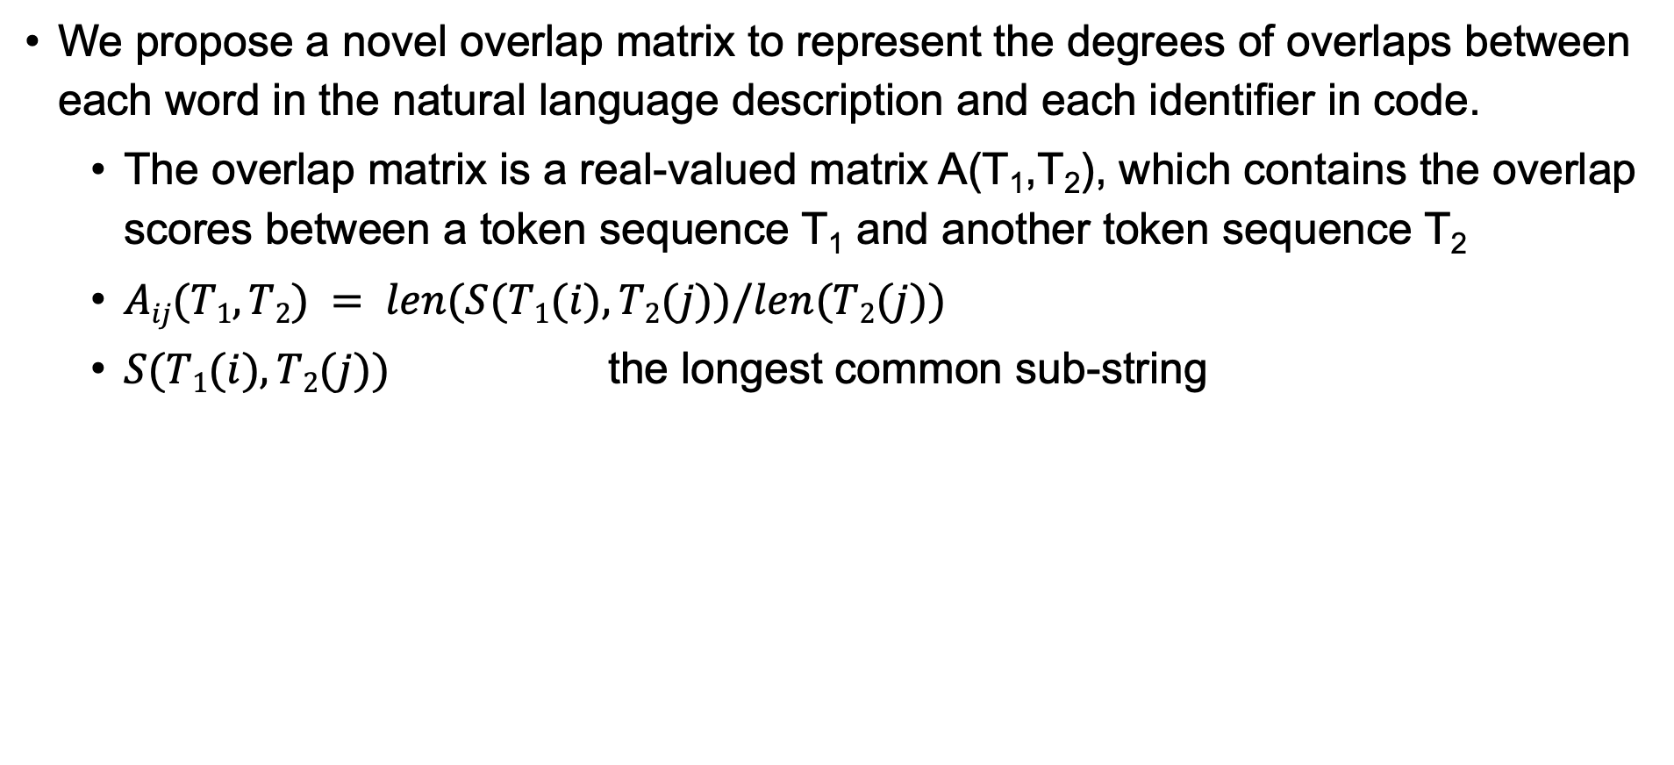
OCoR：Overlap Matrix
We propose a novel overlap matrix to represent the degrees of overlaps between each word in the natural language description and each identifier in code.
The overlap matrix is a real-valued matrix A(T₁,T₂), which contains the overlap scores between a token sequence T₁ and another token sequence T₂
$Aij(T1,T2) = len(S(T1(i),T2(j))/len(T2(j))$
$S(T1(i),T2(j))$ the longest common sub-string
Rows linked by one joint table
MaxPooling
Attention
Insert
Into
Joint_table_b
sid
0.25 |  |  |  | 0.4 | 0.2
0.25 |  |  |  | 0.6 | 0.0
0.25 |  |  |  | 1 | 1
0.25 |  |  |  | 0.2 | 0
Notes:
Then we describe how to extract the overlap information between code snippet and natural language description. We propose a novel overlap matrix to represent the degrees of overlaps between each word in the natural language description and each identifier in code.The overlap matrix is a real-valued matrix, which contains the overlap scores. The overlap score is computed as the equation. S denotes the longest common sub-string of token sequence 1 and token sequence 2. Then we adopt a max-pooling layer over the overlap matrix for further computation.

Slide 11
OCoR
Notes:
This is the overview of our approach, which takes two overlap matrics as input and outputs the relevant score.
The details can be found in our paper, and I will not introduce the details here.

Slide 12
OCoR：Model Combination
We consider to combine different models by integrate the relevance scores computed by different models and output the final relevance score for OCoR. The score is computed by a linear combination as
R(Q,c) = λ ∗ S₁ + (1 − λ) ∗ S₂
Notes:
Because our model focuses on extracting the overlapping information of natural language and code snippets, we consider to combine the previous models with OCoR. We combine different models by integrate the relevance scores computed by different models and output the final relevance score for OCoR. The score is computed by a linear combination.

Slide 13
Evaluation
PART THREE
Notes:
In the last part, I will introduce the evaluation of our paper.

Slide 14
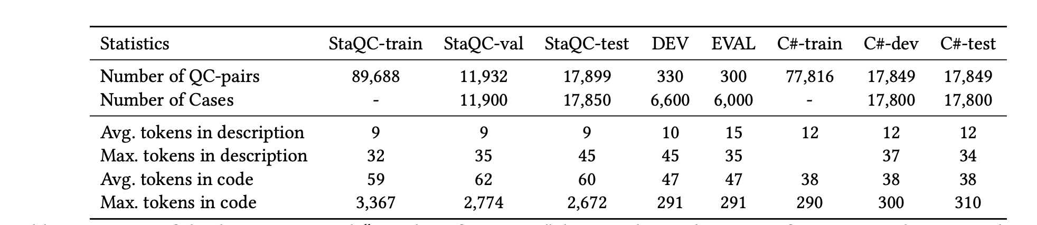
Experiment
We evaluated our approach on two benchmarks.
StaQC benchmark
C# benchmark
Notes:
We evaluated our approach on two types of benchmarks:
The first is StackoverflowQuestionCode benchmark. It contains about 119,000 question-code pairs written in the SQL. These pairs are collected from Stack Overflow [31], making itself the largest-to-date in SQL domain. We followed the original train-dev-test split in the orginal work, namely StaQC-train, StaQCval ,and StaQC-test. For better evaluation , we used two additional test dataset namely “DEV” and “EVAL” for SQL.
The other is the C# benchmark. It contains about 113,000 question-code pairs written in C# collected from StackOverflow.
The statistics of these benchmarks are shown in this table.

Slide 15
Metrics and Baselines
To measure the performance of our approach, we followed previous works and used a standard metrics called Mean Reciprocal Rank (MRR).
Baselines
Deep Code Search
CODE-NN
CoaCor
Notes:
To measure the performance of our approach, we followed previous works and used a standard metrics called Mean Reciprocal Rank (MRR).
In our experiment, we used the existing state-of-art code retrieval approaches as the baselines for comparison.
The first one is Deep Code Search:this work jointly embeds the input code snippets and the input natural language description into a high-dimensional vector space with an RNN based neural network.
The second one is CODE-NN:given an input natural language description, CODE-NN computes the probability of the input for each code.
The last one is CoaCor:CoaCor used a reinforcement learning-based framework to combine code retrieval and code annotation together for enhancing the code retrieval.

Slide 16
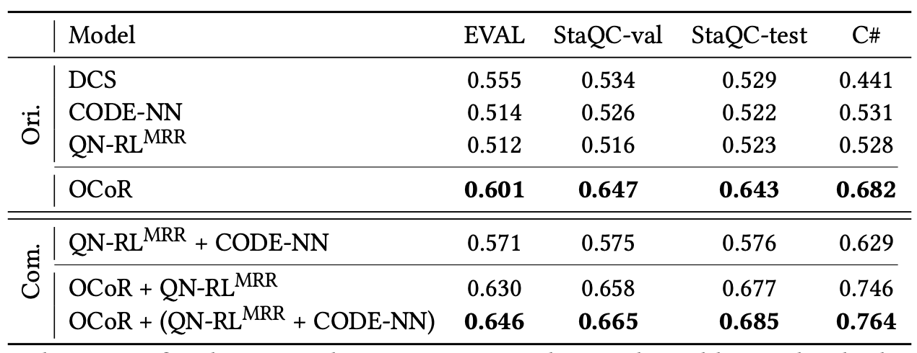
Experiment:Result
Single Model:
0.555 → 0.601
Combined Model:
0.571→ 0.646
Notes:
The experiment shows that our model achieves 5 percentage points MRR improvement with single model and 7 percentage points MRR improvement with model combination.We also conducted an an ablation tet to show the importance of each component in OCoR.

Slide 17
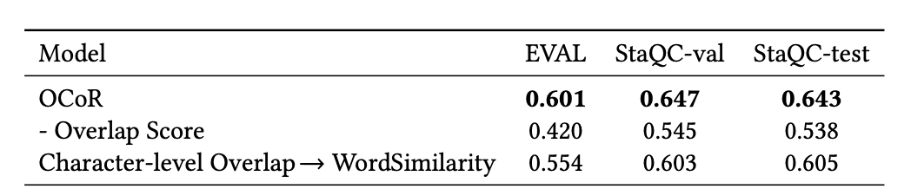
Abaltion Test
We conducted the ablation test on the SQL dataset to figure out the contribution of each component
Notes:
We conducted the ablation test on the SQL dataset to figure out the contribution of each component.
We first removed the input overlap scores from OCoR. To remove this, instead of using overlap matrices as the inputs of the first mechanism in the encoder, we replaced it with the input tokens in natural language description / code. By applying such settings, the performance was closed to the previous approach based on word2vec which shows the effect of the overlap matrix.
we further conducted the experiment on the same datasets but with a different metrics of overlap scores. The baseline metric compared with the original metric is word similarity based on word embedding. We first used the GloVe to pretrain the word embedding vector based on the training set with BPE . Then we use the cosine similarity of two words as the overlap score. The result shows that the character-level metric achieves better performance on all datasets.
#Finally, We also replaced the original overlap metric with Longest Common Prefix.

Slide 18
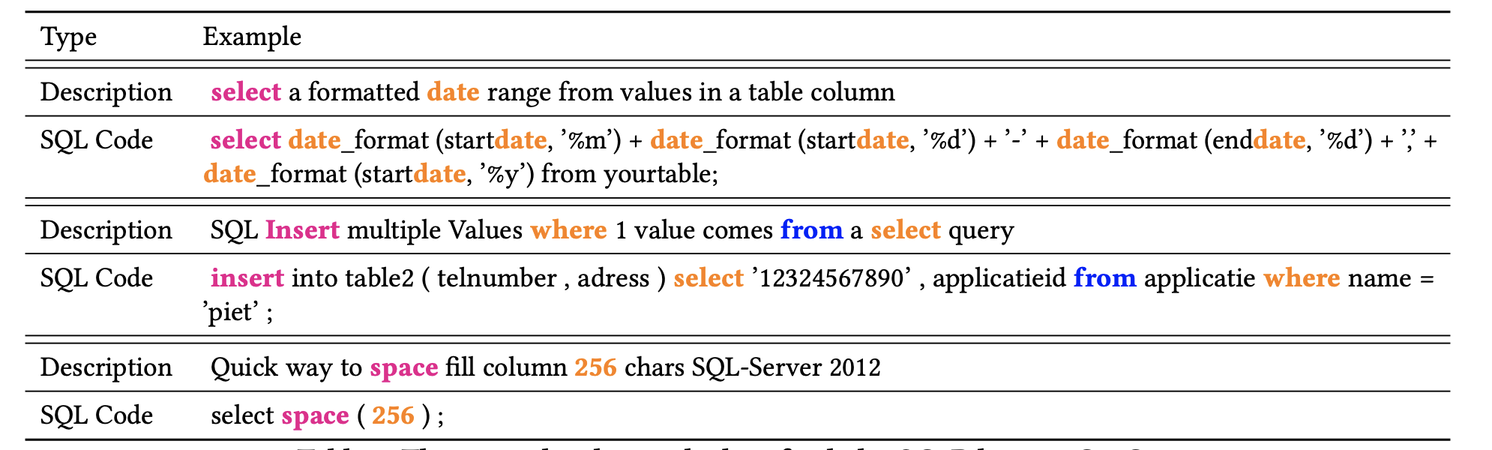
Case Study
To help understand the model combination, we also conducted an case study.
Notes:
Finally, we conduct some cases study. This table shows three examples that are ranked perfectly by OCoR but not CoaCor.
As shown, there are many overlaps between the input natural language description and the code in these examples. However, existing approaches like CoaCor do not utilize the information of overlap scores properly, where the CoaCor approach directly uses the token-level embedding for the neural network and replaces identifier names with numbered placeholder tokens. Thus, CoaCor has a bad performance on these cases.

Slide 19
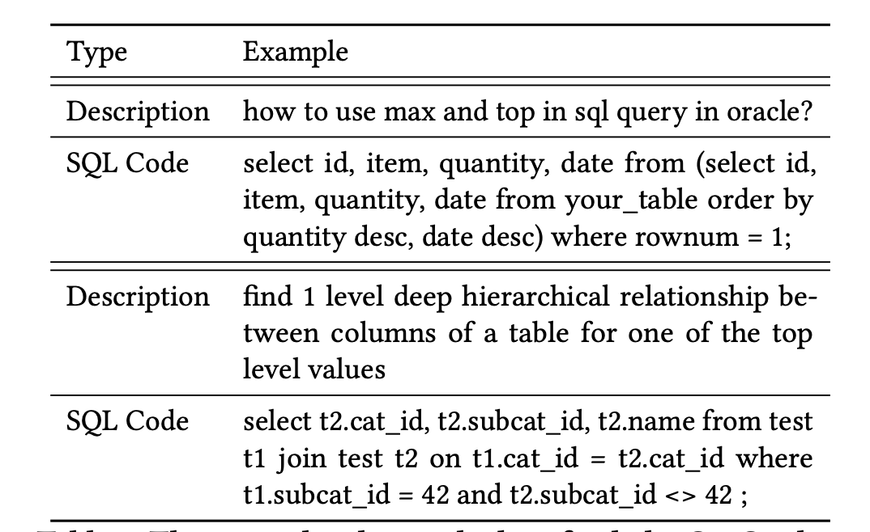
Case Study
To understand the weakness of OCoR, we also conducted another case study on examples where OCoR does not work well compared with the CoaCor
Notes:
To understand the weakness of OCoR, we also conducted another case study on examples where OCoR does not work well compared with the CoaCor.
As shown, in these examples there are few overlaps between the input natural language description and the code in SQL . So, it is probably a good way to combine different approaches together and utilize the strength of each approach. Thus, we use the model combination to combine the strengths of different approaches.

Slide 20
Conclusion
We propose OCoR for code retrieval.
Represent each word by combining the representations of the characters within it
Use a novel overlap matrix to represent the degrees of overlaps.
Combine different models by integrate the relevance scores
The experimental results show that our model significantly outperforms existing approaches.
Notes:
To sum up, we propose OCoR for code retrival.
OCoR uses the character embedding to represent the identifiers and use a novel overlap matrix to represent the degrees of overlaps. We also combine OCoR with previous models by integrate the relevance scores for better performance.
The experimental results show that our approach significantly outperforms existing approaches.

Slide 21


Thanks
TreeGen: A Tree-Based Transformer Architecture for Code Generation
Zeyu Sun, Qihao Zhu, Yingfei Xiong, Yican Sun, Lili Mou, Lu Zhang
szy_@pku.edu.cn
https://github.com/zysszy/AAAI20-ORAL-POSTER
https://github.com/zysszy/TreeGen
Notes:
Thank you for listening.
The code, the PowerPoint, and the poster are available at the links.
If there are any questions, please send emails to me.
Thank you very much.

